Slide 1
Reel-Review
-by Vishanthan shree R

Slide 2
AGENDA
Introduction
Project Architecture
Snapshots
Summary

Slide 3
INTRODUCTION
Reel Review is a web application that allows users to browse and search for movies, create watchlists, and leave reviews. The application uses Angular Material for UI components and Bootstrap for additional styling.

Slide 4
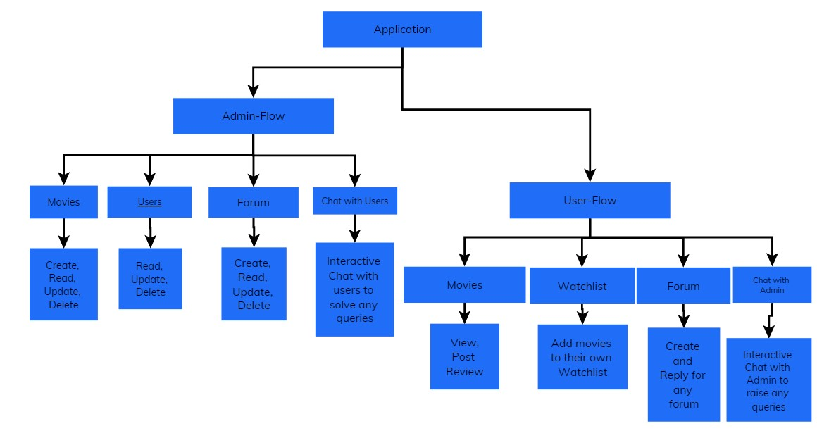
Project Architecture

Slide 5
Project snapshots
Admin Side

Slide 6
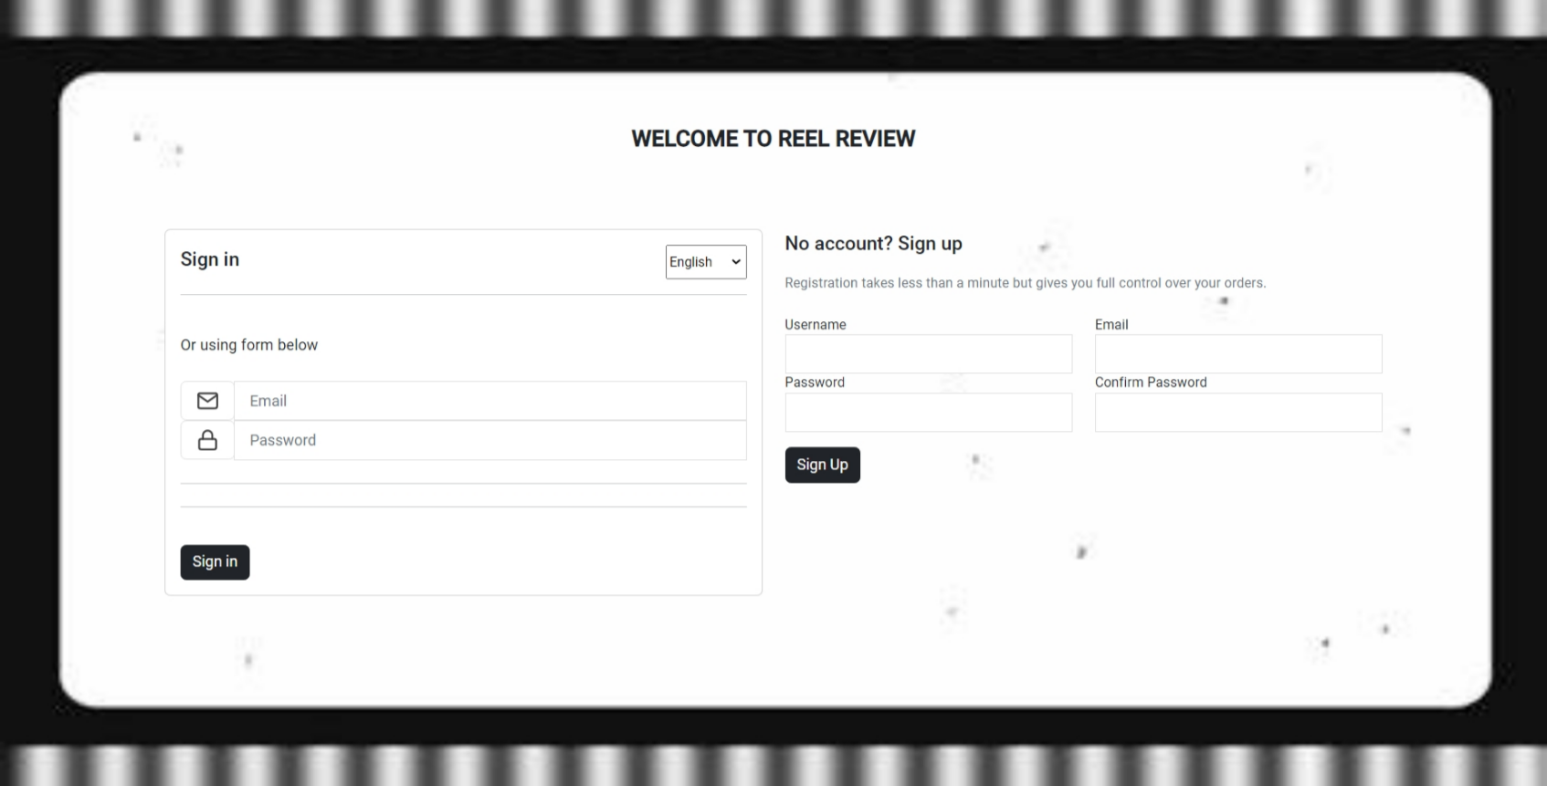
Login page

Slide 7
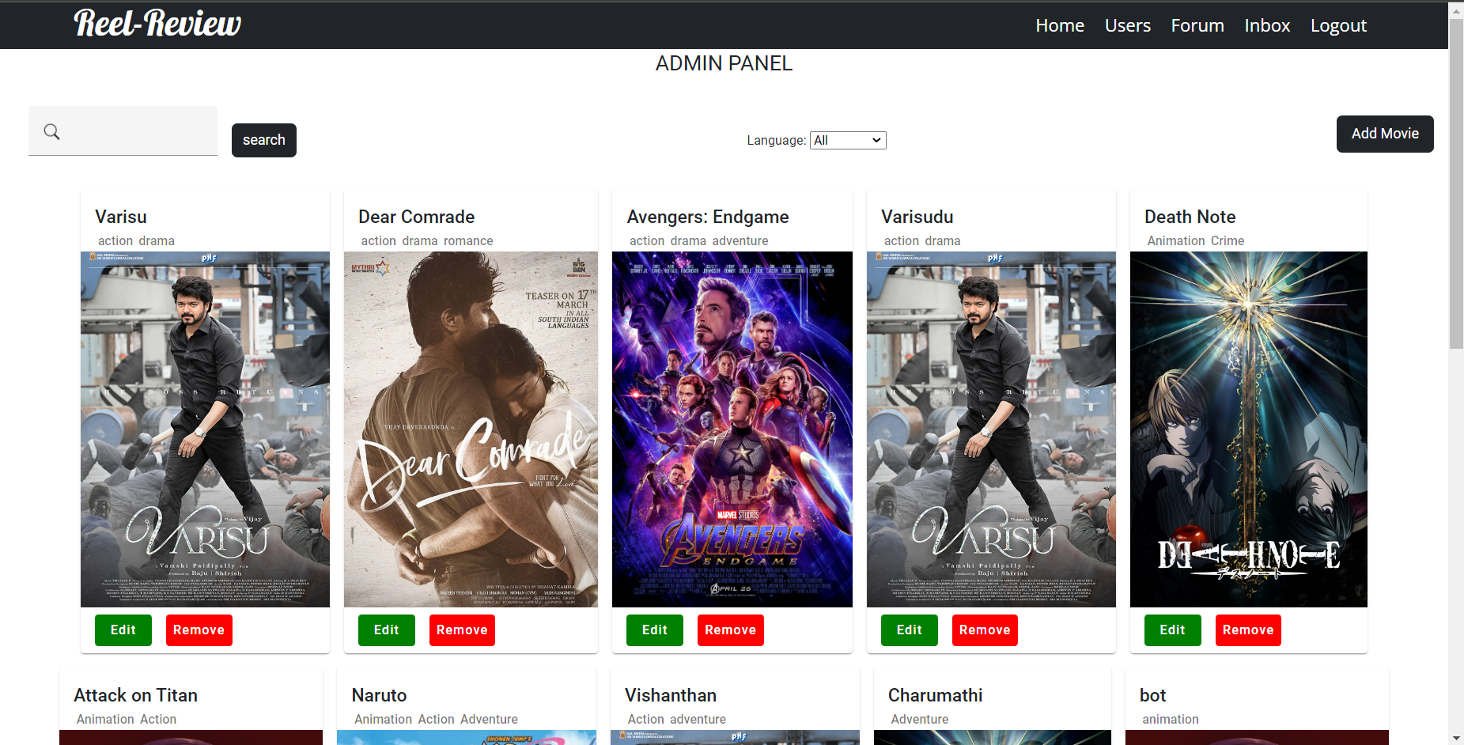
Admin home page

Slide 8
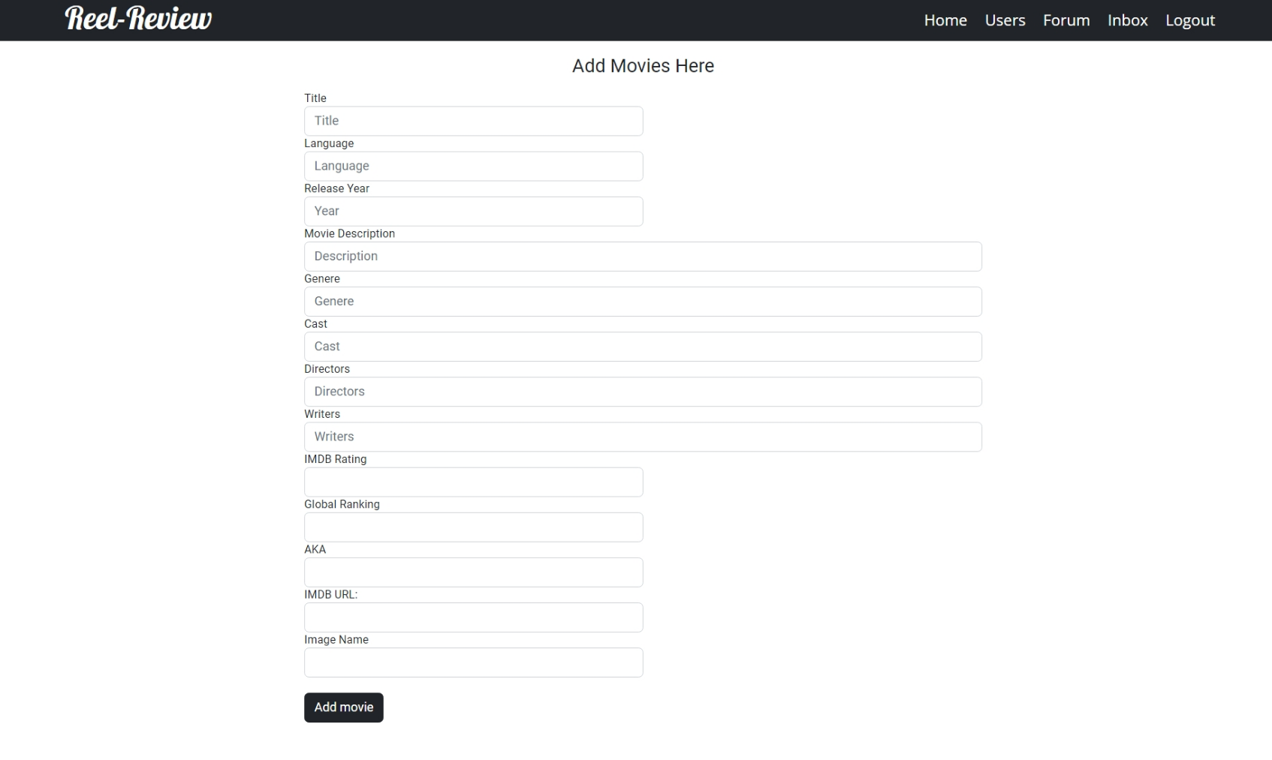
Add movies page

Slide 9
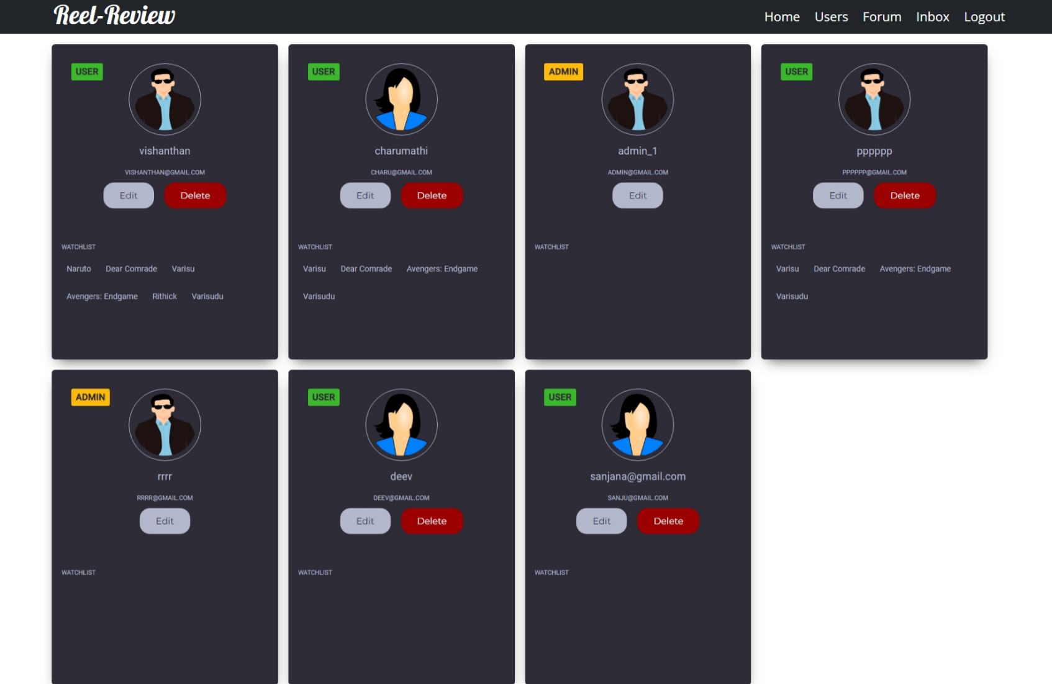
Users Monitoring page

Slide 10
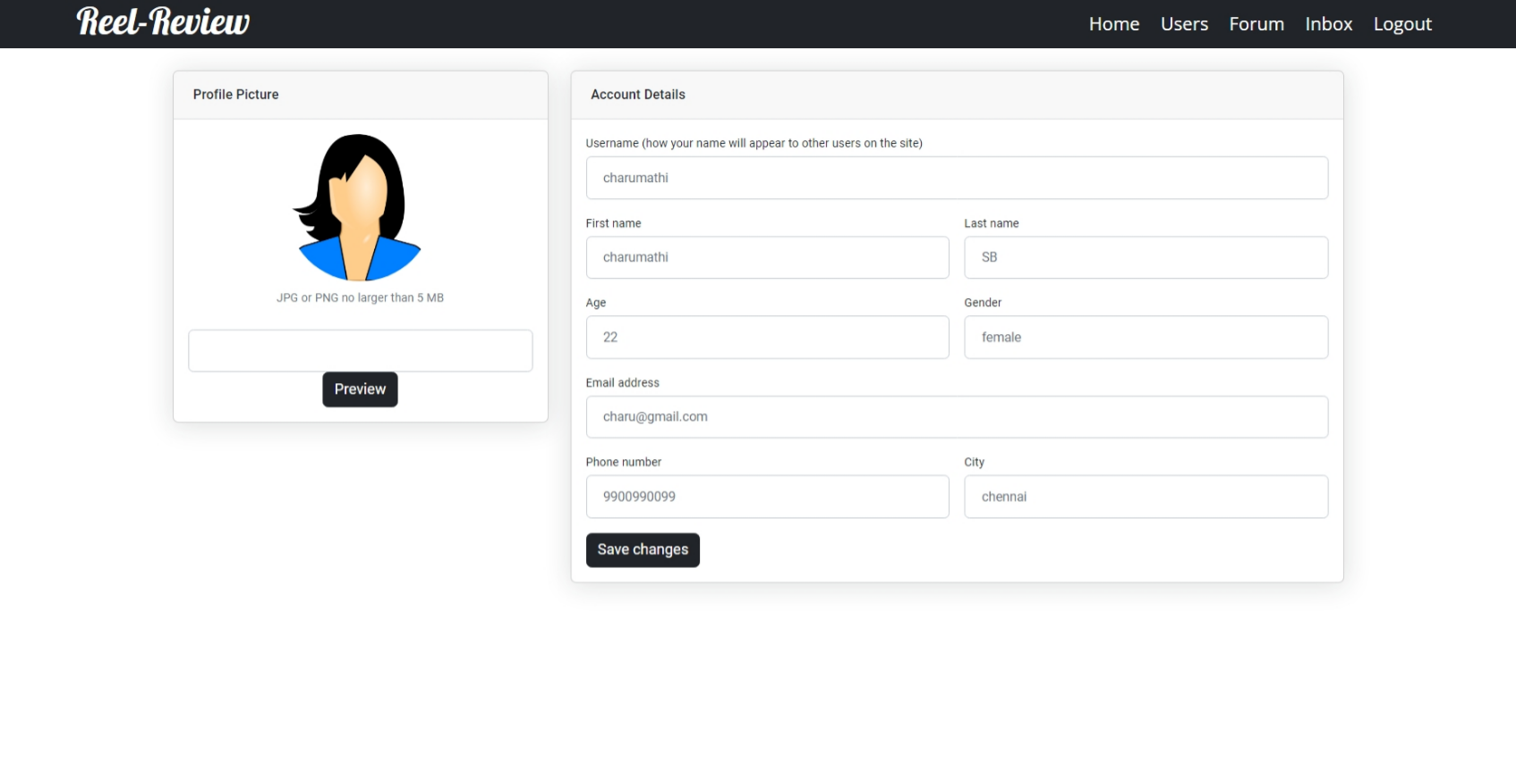
edit users page

Slide 11
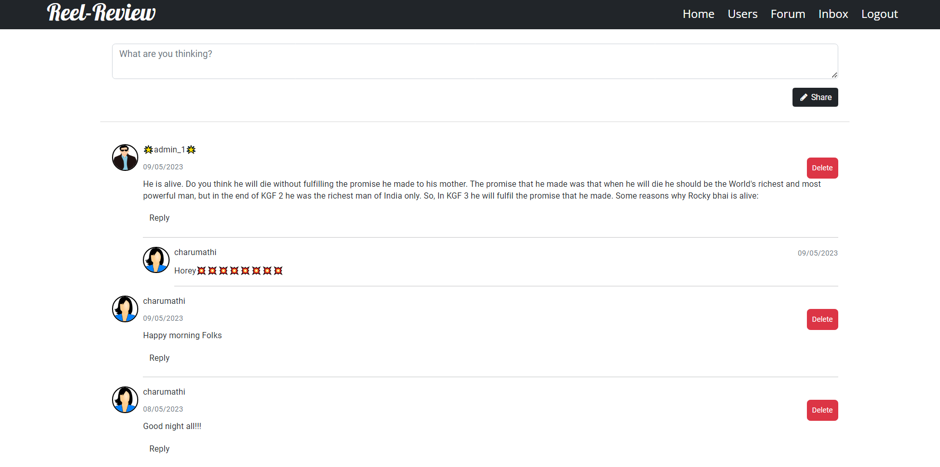
Admin-Forum page

Slide 12
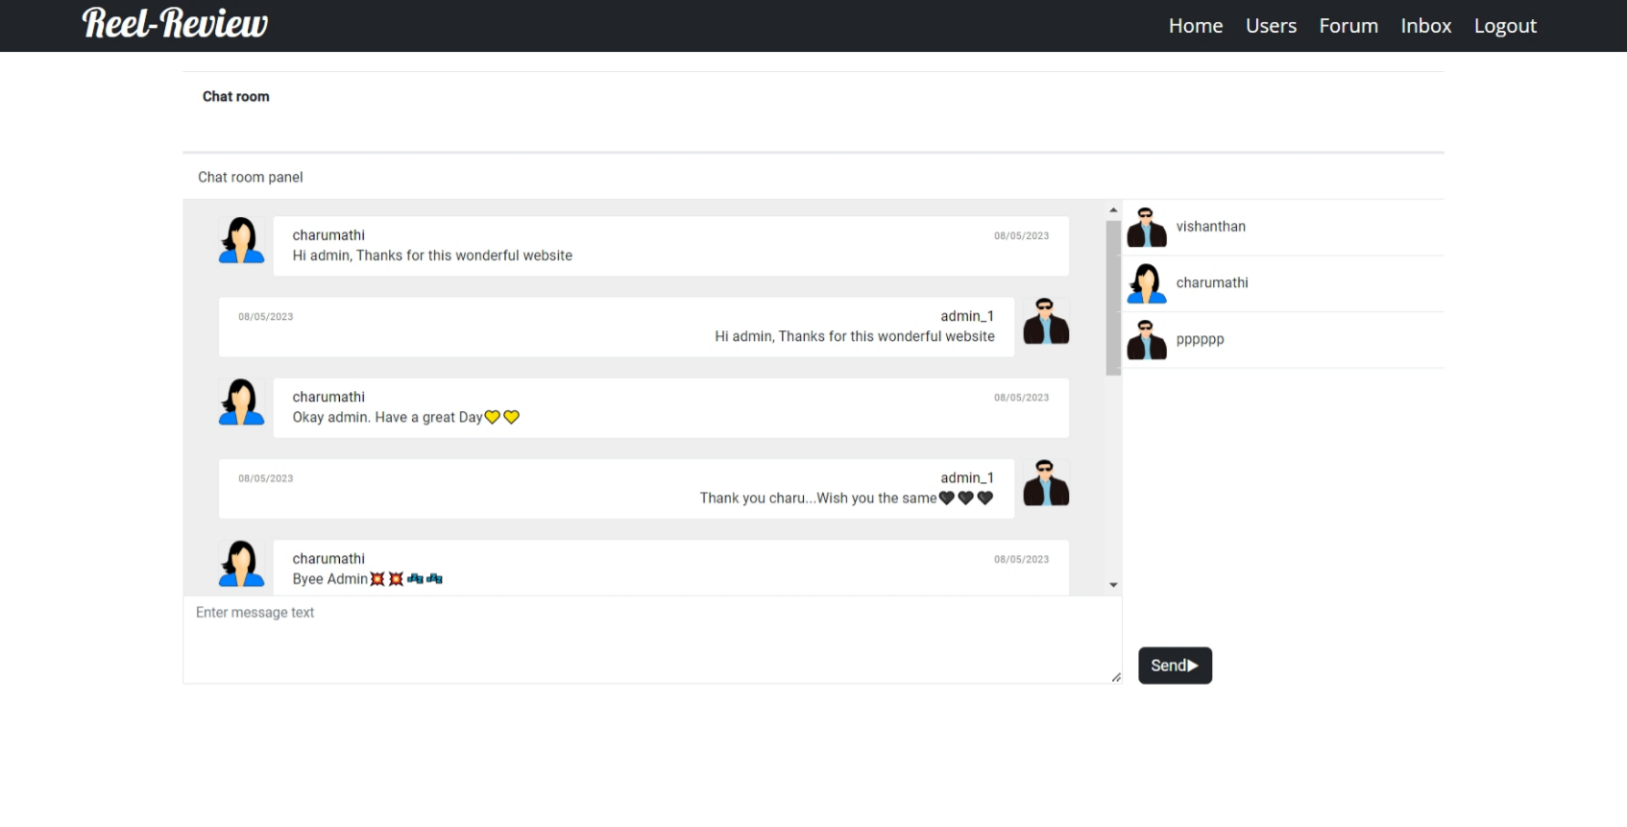
Admin-chat page

Slide 13
Project snapshots
User Side

Slide 14
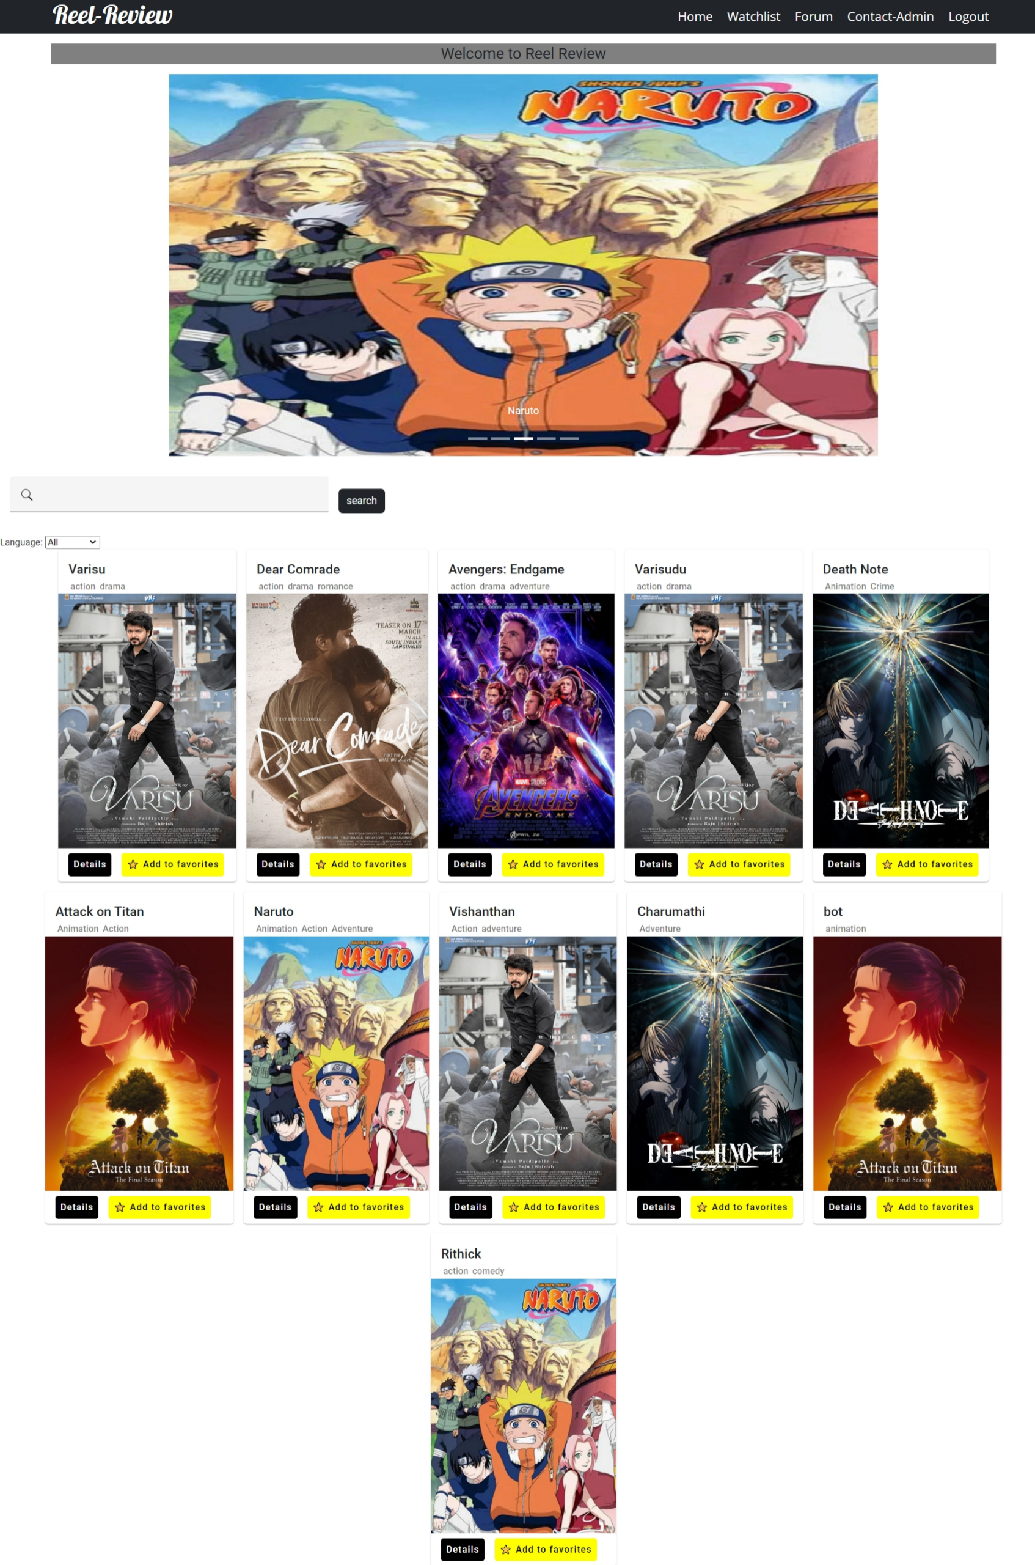
user home page

Slide 15
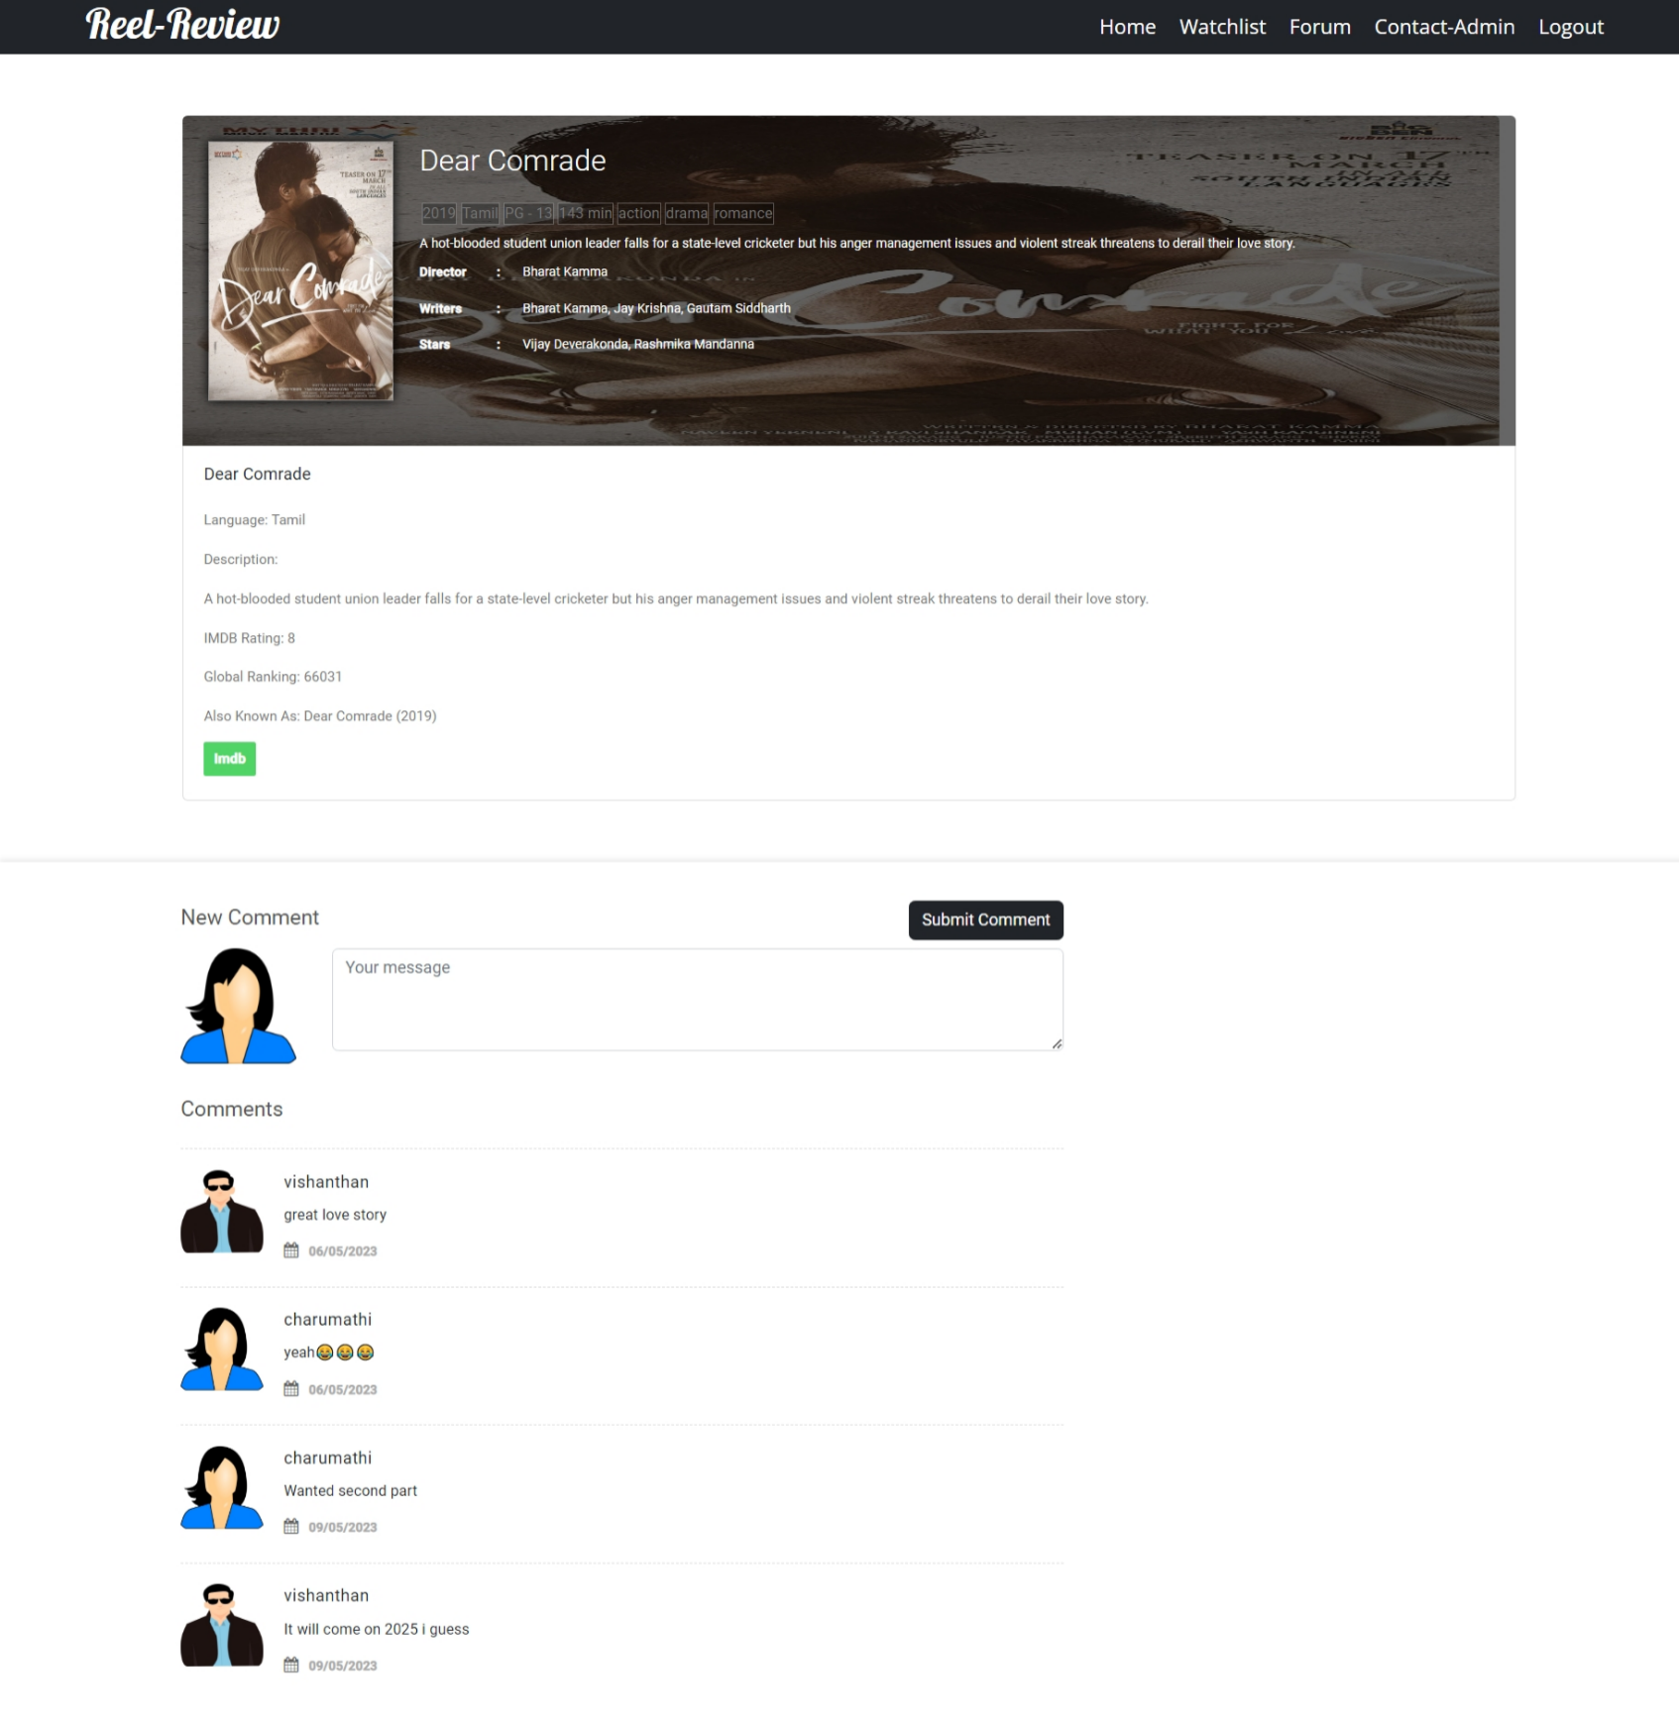
Movie details page

Slide 16
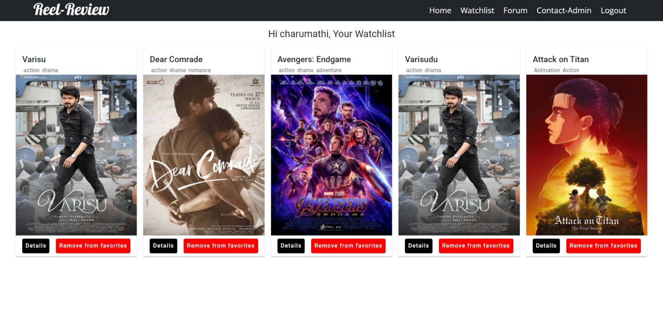
Users watchlist page

Slide 17
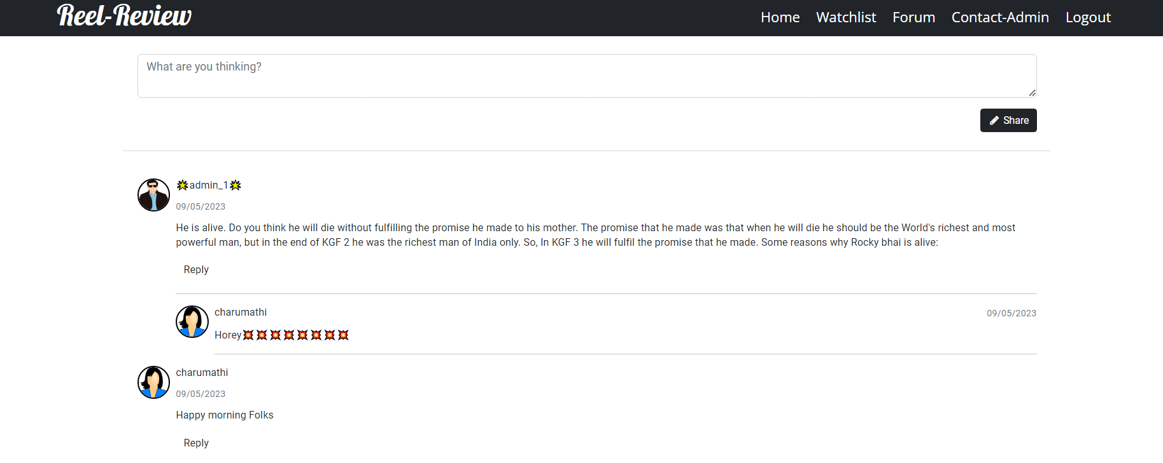
User-Forums page

Slide 18
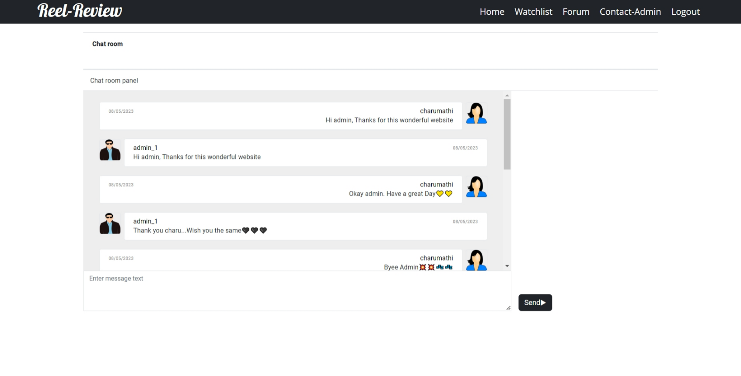
Contact admin page

Slide 19
THANK YOU
Vishanthan shree R
Vishanthan8055@gmail.com
Vishanthan.r@dedalus.eu

